Slide 1
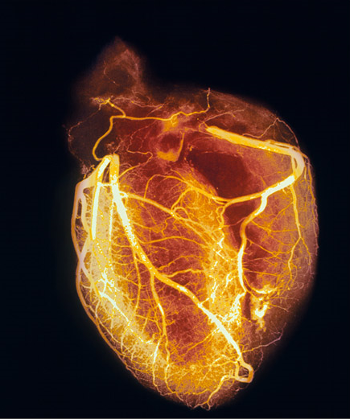
Cardiovascular System
The Heart

Slide 2
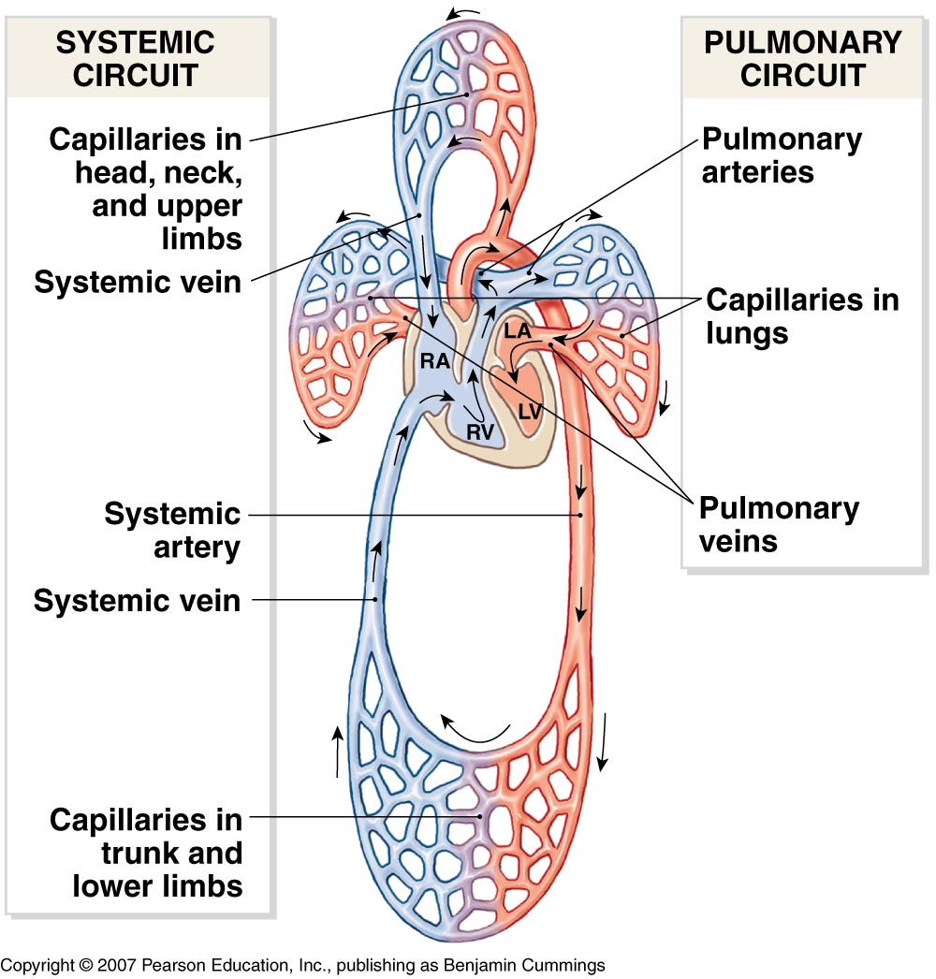
Cardiovascular System –
The Heart Overview
What does the heart do?
  By timed muscular contractions creates pressure gradients
    blood moves then from high pressure to low pressure from chamber to chamber
    The timed muscular contractions occur in each side (pump) of the heart
      Right side = pulmonary circuit
      Left side = systemic circuit
Where should the lowest pressure be to make blood circulate?

Slide 3
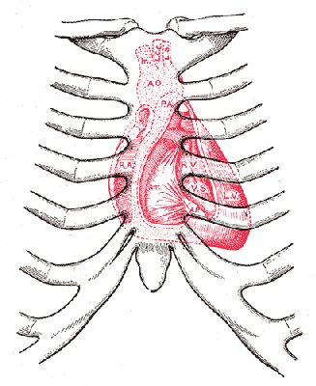
Cardiovascular System –
The Heart Overview
Physical Location & Size:
  In the medastinum, intermediate to the sternum and vertebral column and intermediate to the right and left lungs, and superior to the diaphragm..
  Size: approximately the size of your fist
Diaphragm

Slide 4
Cardiovascular System –
The Heart Overview
Location of the heart with respect to the vasculature of the cardiovascular system
  Between veins and arteries!
    Veins Visit!
    Arteries Away!
    What do capillaries do?
      Exchange – they are between arteries and veins
Veins
Arteries
Veins
capillaries
Arteries

Slide 5
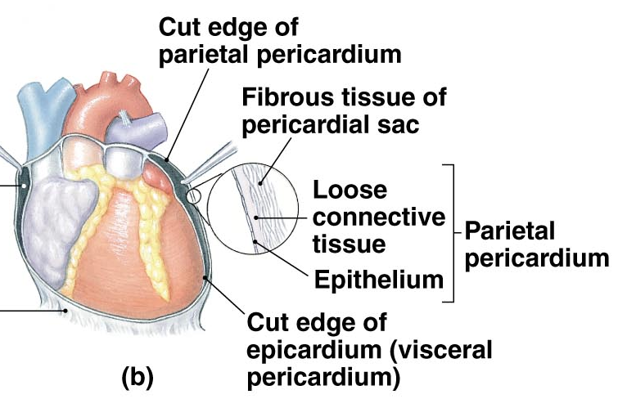
Cardiovascular System –
The Heart Overview
The Pericardial Membranes
  Create the pericardial cavity. . . Why is it needed?
    The parietal pericardium consists of:
      An outer membrane of the fibrous parietal pericardium
        dense irregular connective tissue
      An inner serous membrane
    The visceral pericardium consists of:
      A thin membrane on the surface of the heart

Slide 6
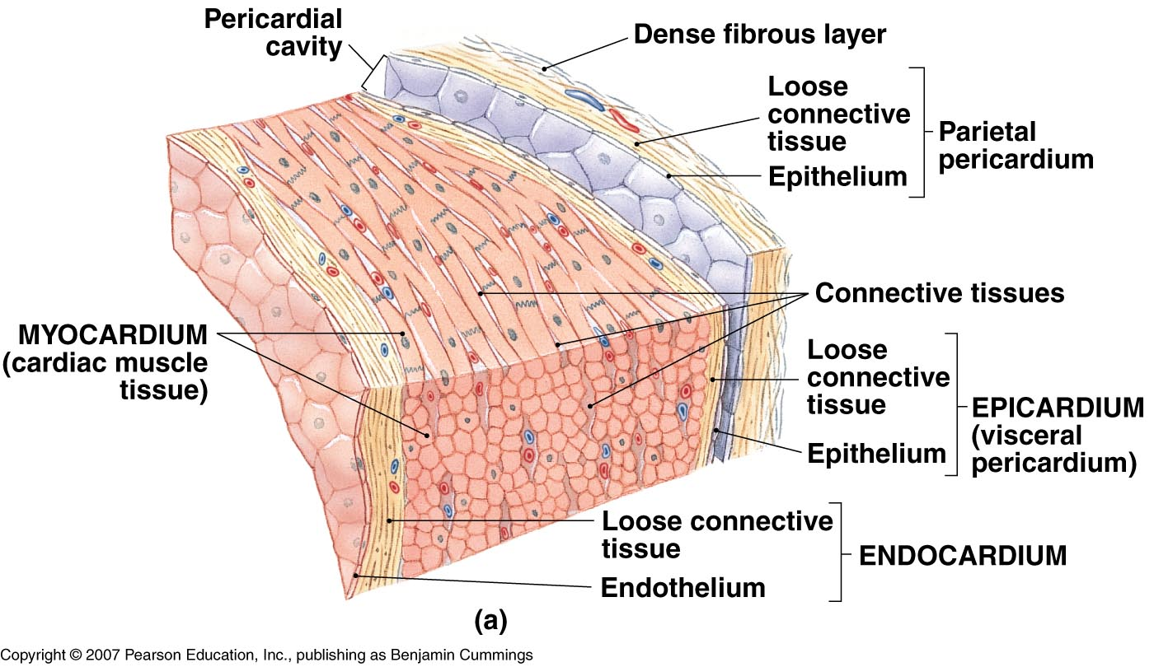
The Heart – Layers
The Heart Wall
  Muscle (myocardium) sandwiched between an
  inner layer (endocardium) and an
  outer layer (epicardium – same as the visceral pericardium)

Slide 7
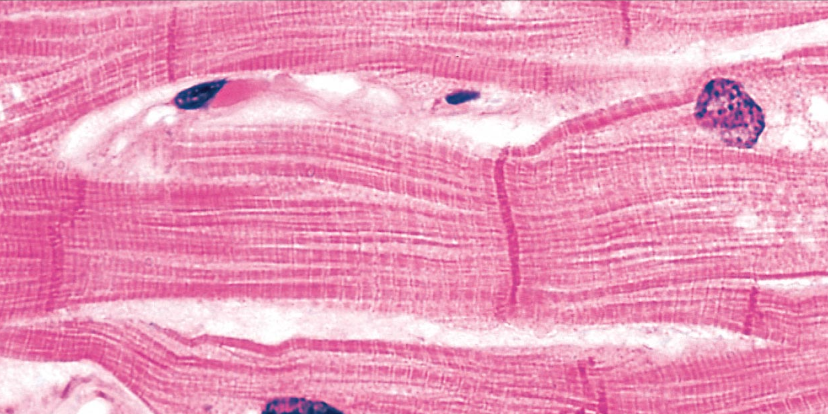
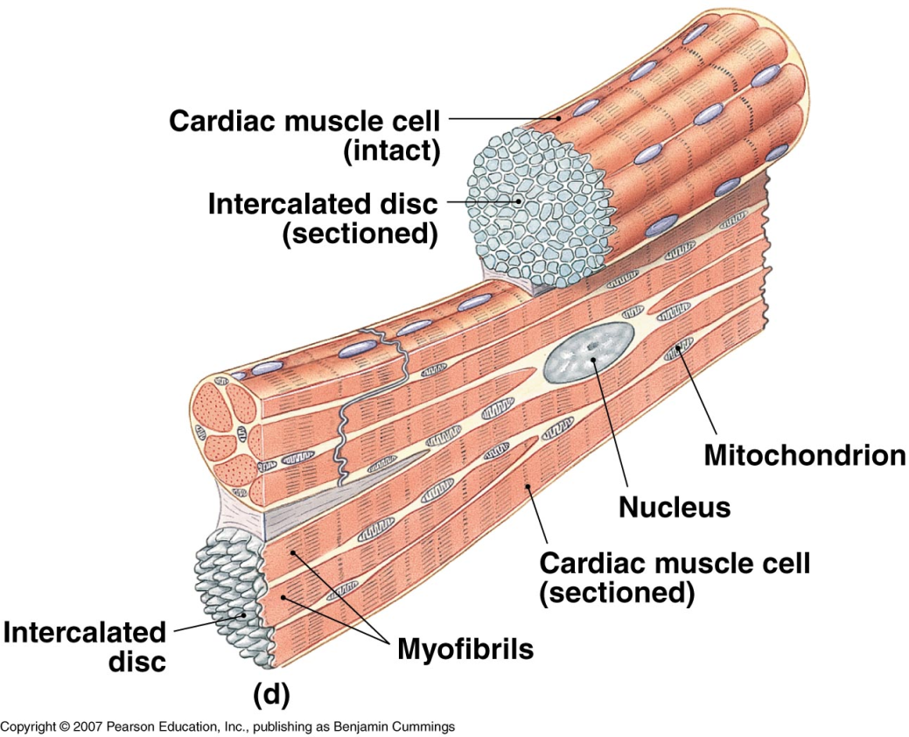
The Heart –
Cardiac Muscle Features
Cardiac Muscle Cells
  Shorter than skeletal muscle fibers & are branching
  Have single nucleus
  Have striations
  Depend on aerobic metabolism
  Connected by intercalated discs
  Desmosomes transmit tension
  Gap junctions transmit ions (think action potential transmission)

Slide 8
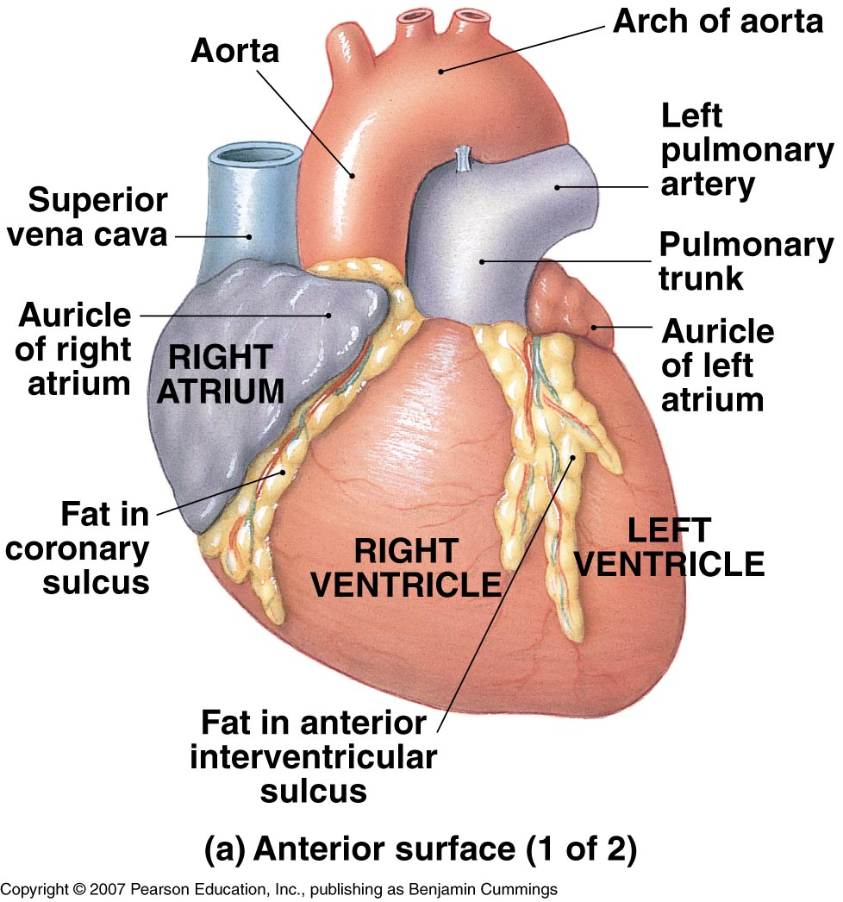
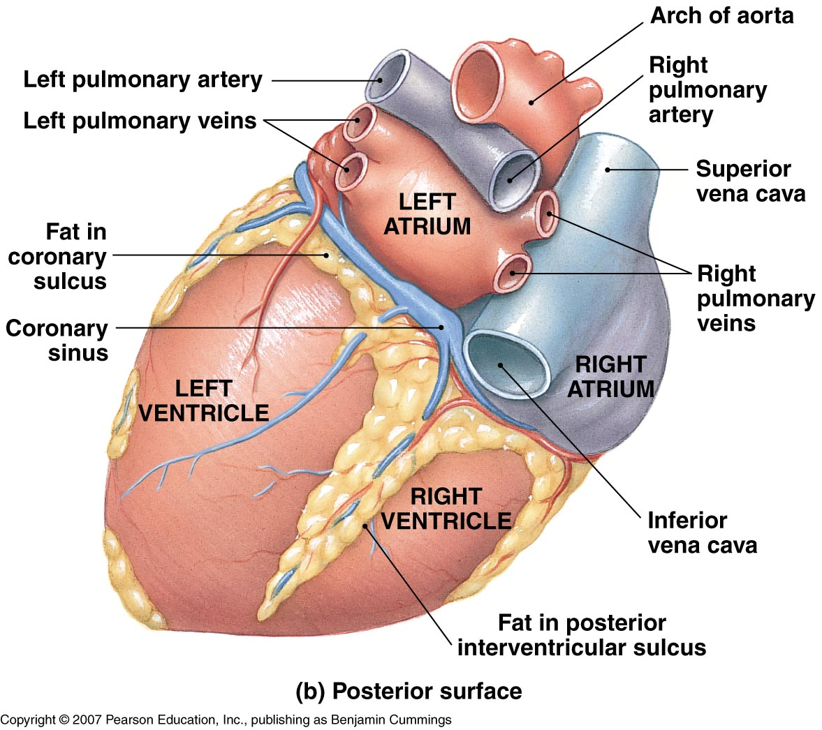
The Heart – External Features

Slide 9
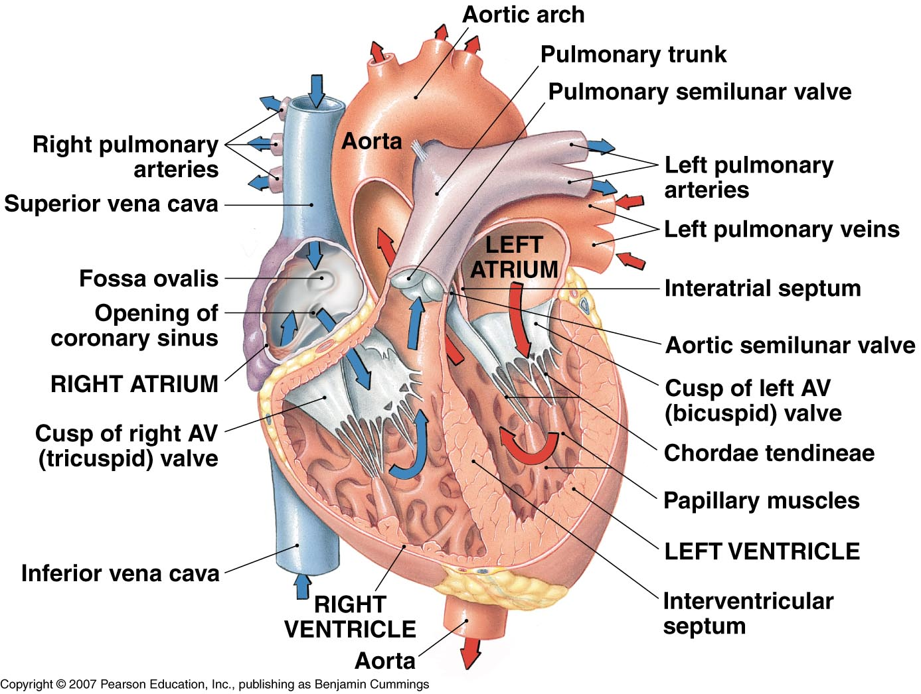
The Heart – Internal Features
Key Features:
  Septum
  Valves

Slide 10
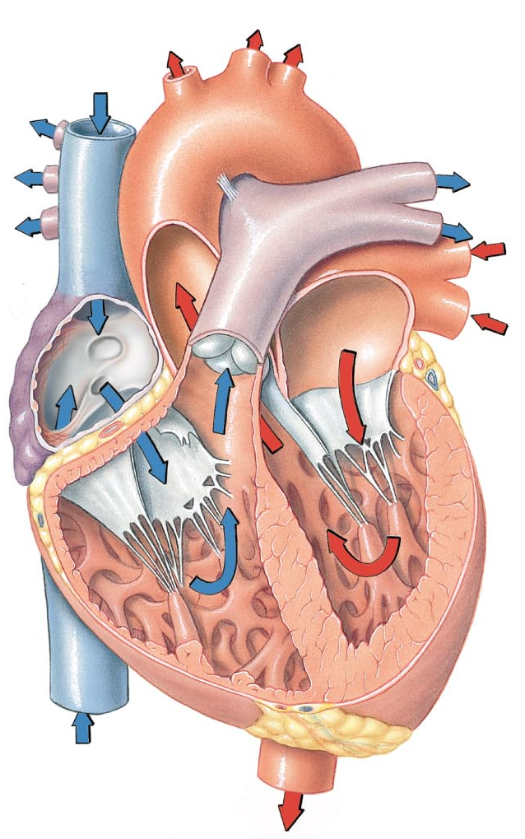
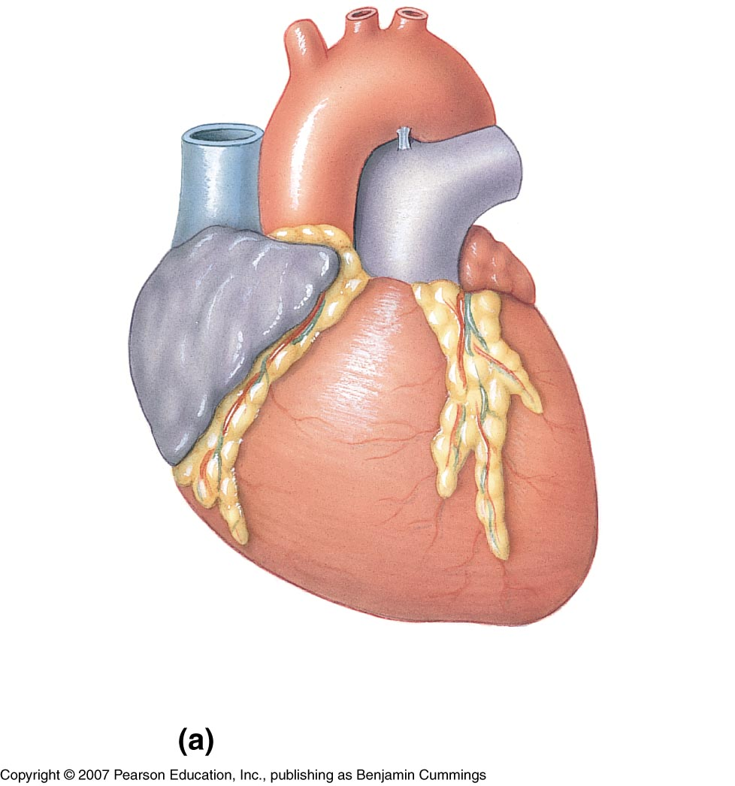
The Hearts Chambers
Each side of the heart (left and right) has two chambers
  Atria
    Superior chambers at the base of the heart, receive blood from the body and from the lungs
  Ventricles
    Inferior chambers receive blood from the atria and contract to move blood into the lungs and body
LA
RA
LV
RV

Slide 11
The Heart – Blood Flow
Systemic blood enters the Right Atrium via the Superior & Inferior Vena Cava & the Coronary Sinus
Blood passes through the right atrioventricular valve (R.A.V) or tricuspid valve to enter the Right Ventricle
Contraction of the Right Ventricle forces blood through the Pulmonary Semilunar Valve (Pulmonic Valve) into the Pulmonary Trunk (artery)
Pulmonary Arteries transport blood to the lungs, and pulmonary veins transport blood back to the left atrium
Blood passes through the left atrioventricular valve (LAV) or bicuspid or mitral valve to enter the left ventricle
Contraction of the left ventricle forces blood through the aortic semilunar valve (aortic valve) and into the aorta
The aorta and its branches supply the body with arterial blood which is then exchanged in the tissues and returned to the heart via veins leading into the vena cavae.

Slide 12
The Heart – Coordinating it all
The Conducting System & The Myocardium
  Initiates and spreads electrical impulses in heart (CS)
  Two types of cells
    Nodal cells or Pacemaker cells
      Reach threshold first
      Set heart rate
    Conducting cells
      Distributes stimuli to myocardium
Myocardium – specialized cells with unique action potential
  Differences between Cardiac and Skeletal Muscle Cells
    Cardiac action potential has long plateau phase
    Cardiac muscle has long, slow twitch
    Cardiac muscle has long refractory period
    Can’t be tetanized

Slide 13
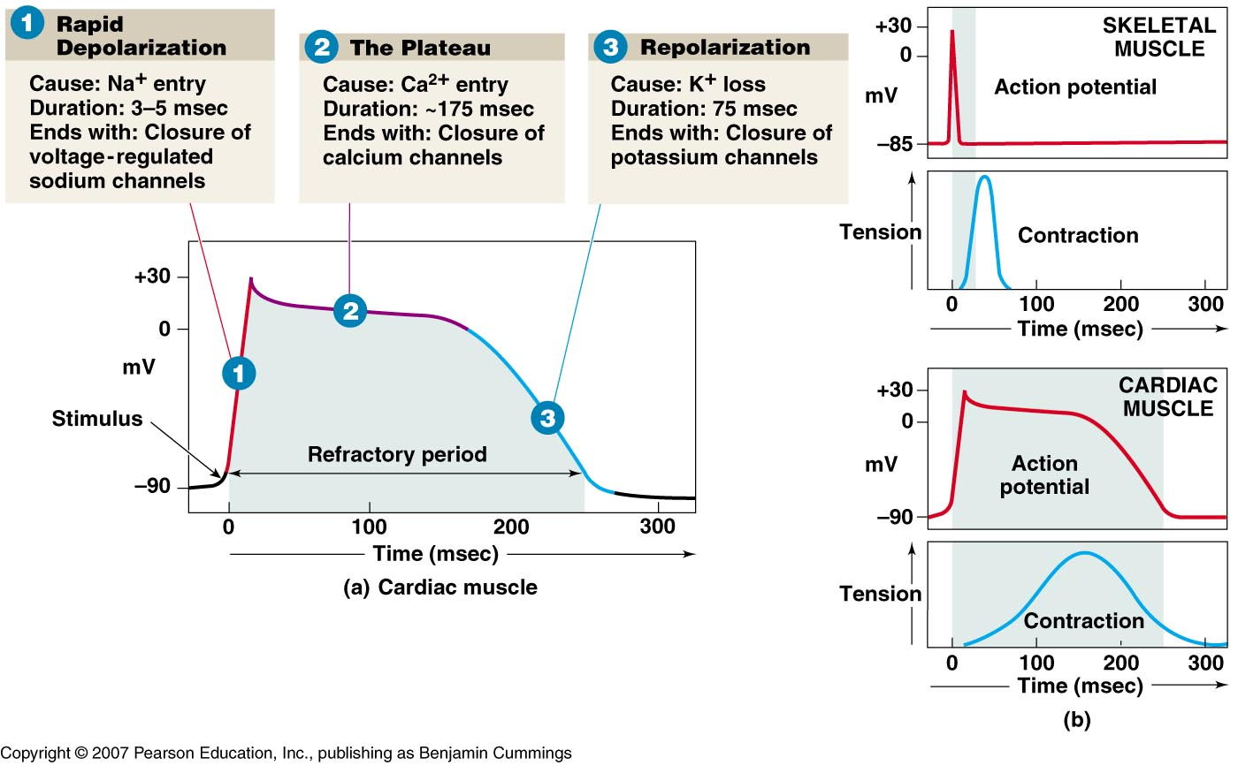
Cardiac Muscle Action Potential

Slide 14
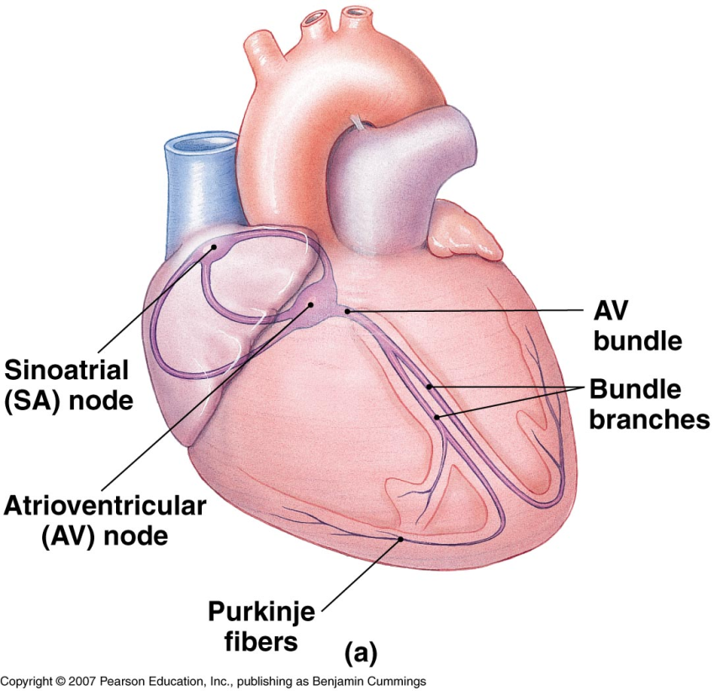
The Heart –
The Conduction System
Pacemaker cells establish heart rate
Normal pacemaker is sinoatrial (SA) node
Impulse spreads from SA node:
  Across atria
To atrioventricular (AV) node
To AV bundle and bundle branches
Via Purkinje fibers (conduction
myofibers) to ventricles

Slide 15
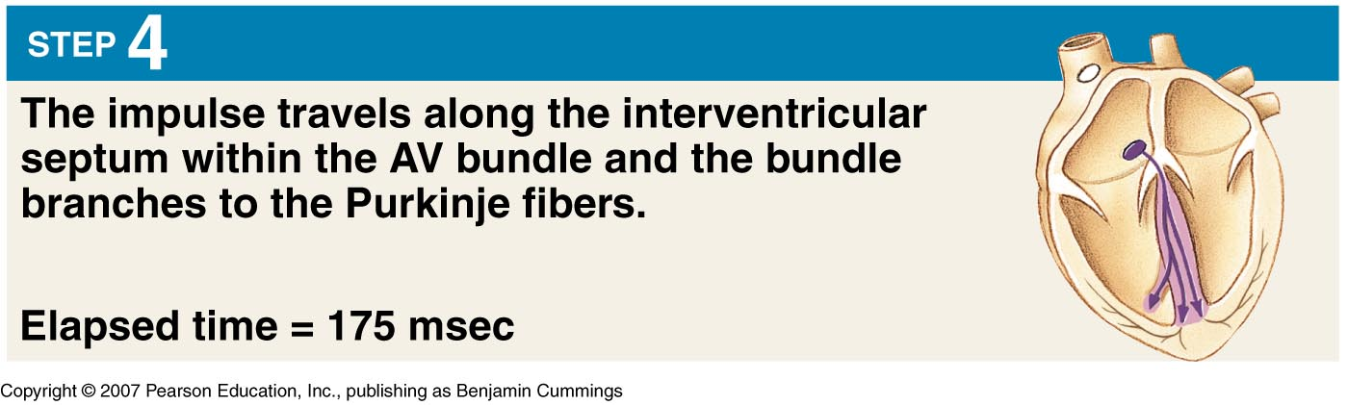
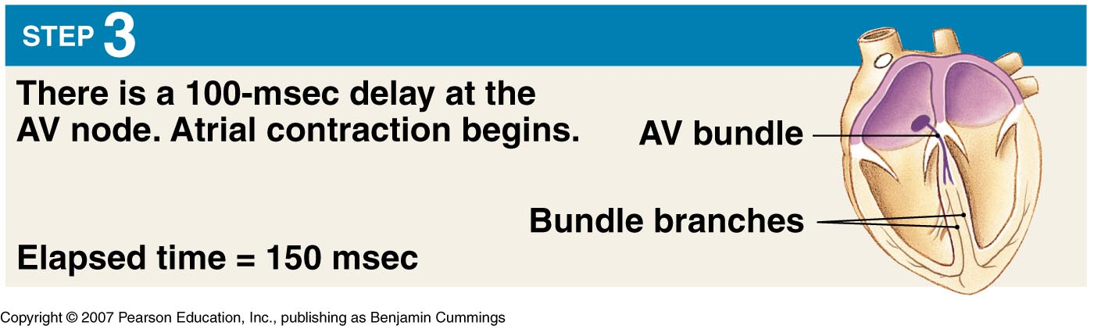
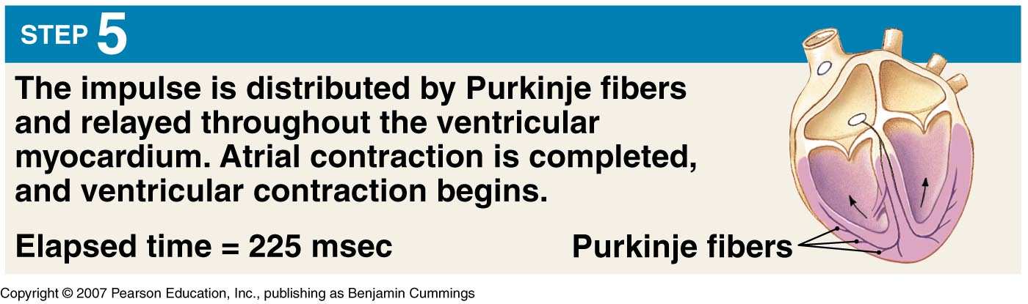
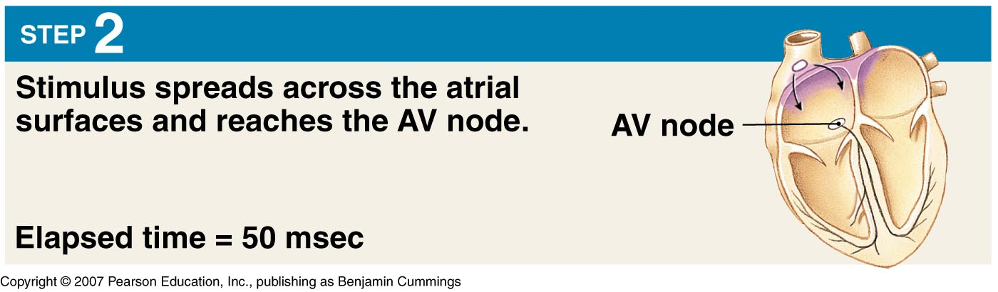
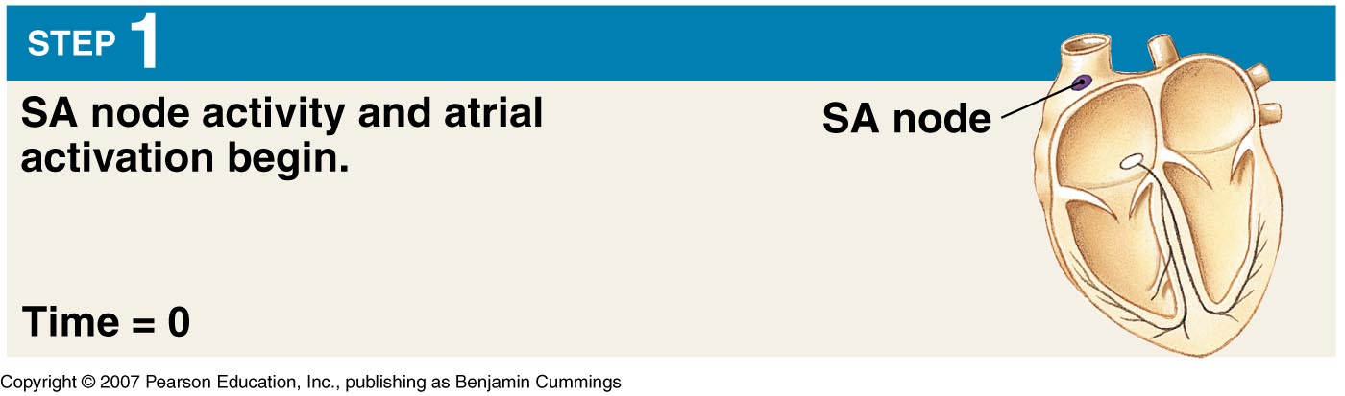
The Heart –
The Conduction System

Slide 16
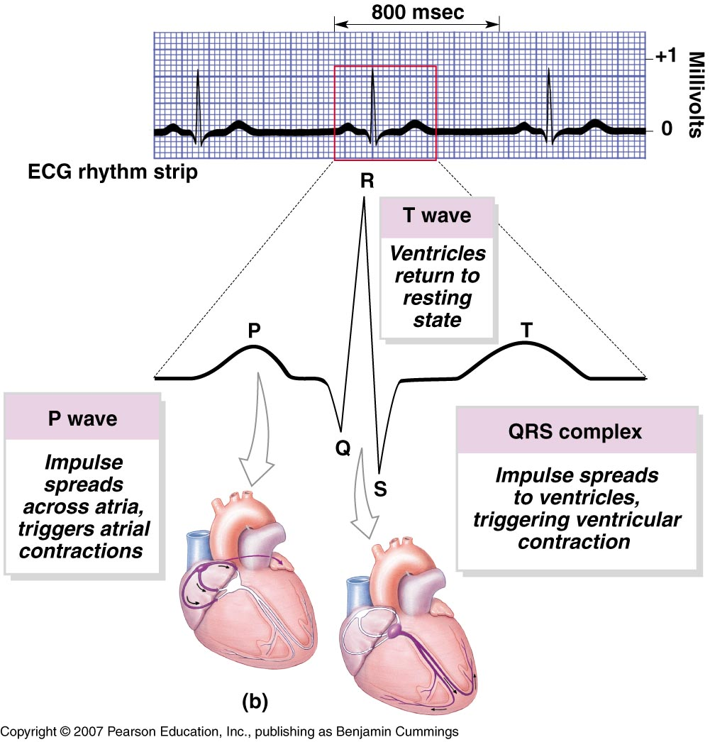
The Heart –
Electrical Activity Recorded, The ECG
ECG records the electrical activity of the heart during cardiac cycles
P wave
  Atrial depolarization
QRS complex
  Ventricular depolarization & atrial repolarization
T Wave
  Ventricular depolarization

Slide 17
Putting it all together –
The Cardiac Cycle
Two phases in cardiac cycle
  Systole
    Contraction phase
    Both chambers will have periods of systole
  Diastole
    Relaxation phase
    Both chambers will have periods of diastole
    The cardiac cycle is the alternation of these two phases…
      First atrial systole and ventricular diastole, then atrial diastole and ventricular systole and back to systole…

Slide 18
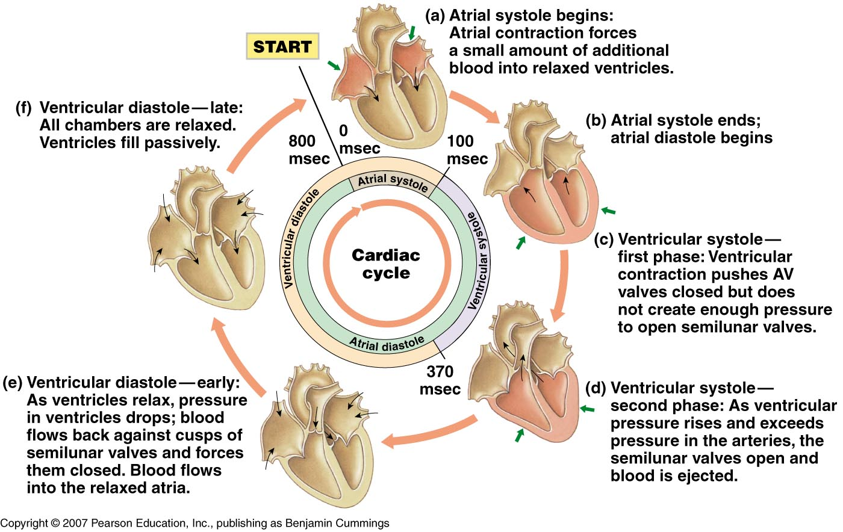
The Cardiac Cycle

Slide 19
The Heart – Cardiac Output
First…
Stroke volume
  The amount of blood that is ejected from the left ventricle during one systolic event
  Cardiac Output
    The volume of blood ejected from the left ventricle during one minute
    Calculated by
      Stroke Volume X Heart Rate (bpm) = C.O.

Slide 20
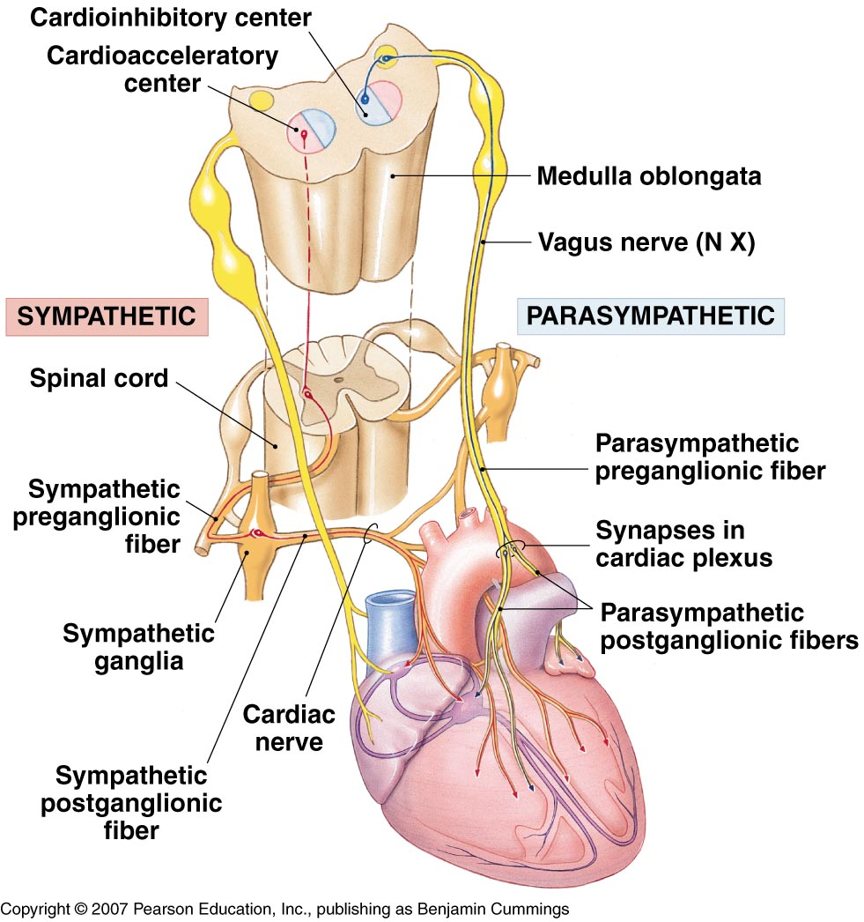
The Heart – Cardiac Output
Factors Controlling Cardiac Output
  Blood volume reflexes
    Stimulated by changes in venous return
    VR is amount of blood entering
    heart
    Atrial reflex
      Speeds up heart rate
      Triggered by stretching wall of
      right atrium
    Frank-Starling principle
      Increases ventricular output
      Triggered by stretching wall of
      ventricles
  Autonomic innervation
    Parasympathetic innervation
      Releases acetylcholine (ACh)
      Lowers heart rate and stroke
      volume
    Sympathetic innervation
      Releases norepinephrine (NE)
      Raises heart rate and stroke
      volume

Slide 21
The Heart – Cardiac Output
Hormone Effects on Cardiac Output
  Adrenal medulla hormones
    Epinephrine, norepinephrine released
    Heart rate and stroke volume increased
Other hormones that increase output
  Thyroid hormones
  Glucagon

Slide 22
The Heart – Cardiac Output
CNS Control of the Heart
  Basic control in medulla
  oblongata
  Cardioacceleratory center
    Activation of sympathetic
    neurons
  Cardioinhibitory center
    Governing of parasympathetic
    neurons
  Other inputs
    Higher centers
    Blood pressure sensors
    Oxygen, carbon dioxide
    sensors

