Slide 1
Defense
&The Immune System
Overview

Slide 2
Immune System Agenda
The bigger picture
Non specific defenses
Specific defenses (Immunity)

Slide 3
Defense & the Immune System
Big Picture
Defense
  Any means of preventing or destroying disease causing agents
  May be non-specific or specific defenses (immunity)
Immune system provides
  Specific Protection against foreign material (bacteria, viruses, toxins, cells…)
  How?
    By constantly surveying tissues for things that don’t belong
      Foreign cells, dead cells, viruses, bacteria, toxins
    How do the surveyors know?
      By constantly comparing a known pattern of surface markers to newly encountered items.
      When surface markers don’t match… immune system is activated

Slide 4
Non-Specific Defense
Goal is to
  prevent the entrance of disease causing agents and destroy those that may have entered the body tissues
Accomplished by
  Physical barriers
    Skin, mucous membranes, ciliated epithelium, tears, gastric juices
  Non-specific defenses in blood
    Interferons
      intercellular chemical signals from infected cells
    Complement
      Proteins which cause destruction of bacteria
    Natural Killer cells
      destroy abnormal or foreign cells
    Phagocytes
      ingest and digest foreign material
    Mast cells
      release histamine
    Fever
      Decreases hospitality of the host for the invader

Slide 5
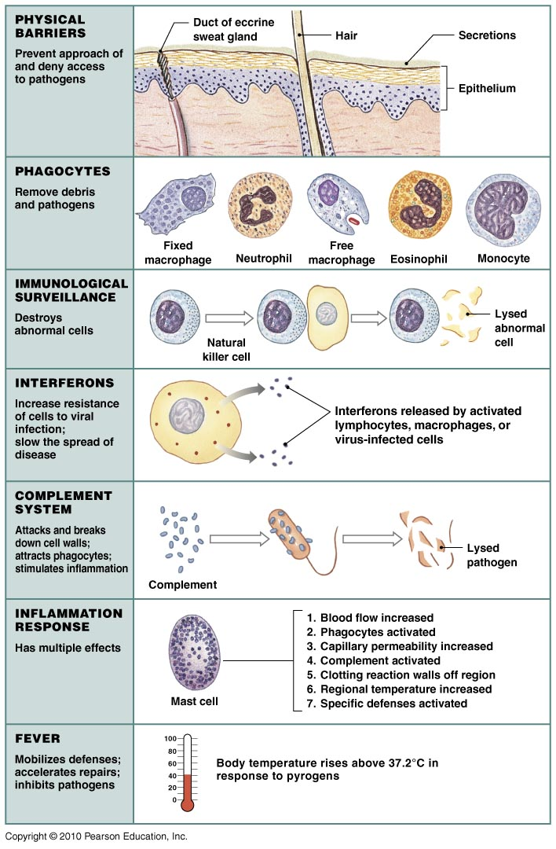
Non-Specific
Defenses

Slide 6
Specific Defenses (Immunity)
What makes this defense specific?
  the production or use of antibodies or T cells that are “grown” specifically for an antigen
    Defense cells involved in immunity are
      B cells (antibody mediated), when activated produce
        plasma cells
          produce antibodies
        memory cells
          create long term immunity
      T cells (cell mediated), when activated produce
        produce T killer (cytotoxic) cells – to destroy
        Produce T helper cells – to help out in the activation process
        produce memory T cells long term immunity

Slide 7
Specific Defenses (Immunity)
Immunity may be
  Innate – genetic basis
  Acquired - may be
    a. Actively
      Naturally
        Obtained the disease on your own from your environment
        Made your own antibodies or T cells for that disease agent
      Induced
        Where given an injection of dead agents
        Made your own antibodies or T cells for that disease agent
    b. Passively – Transfer of antibodies from another individual
      Naturally
        From mother through placenta or breast milk
      Induced
        Given an injection of antibodies

Slide 8
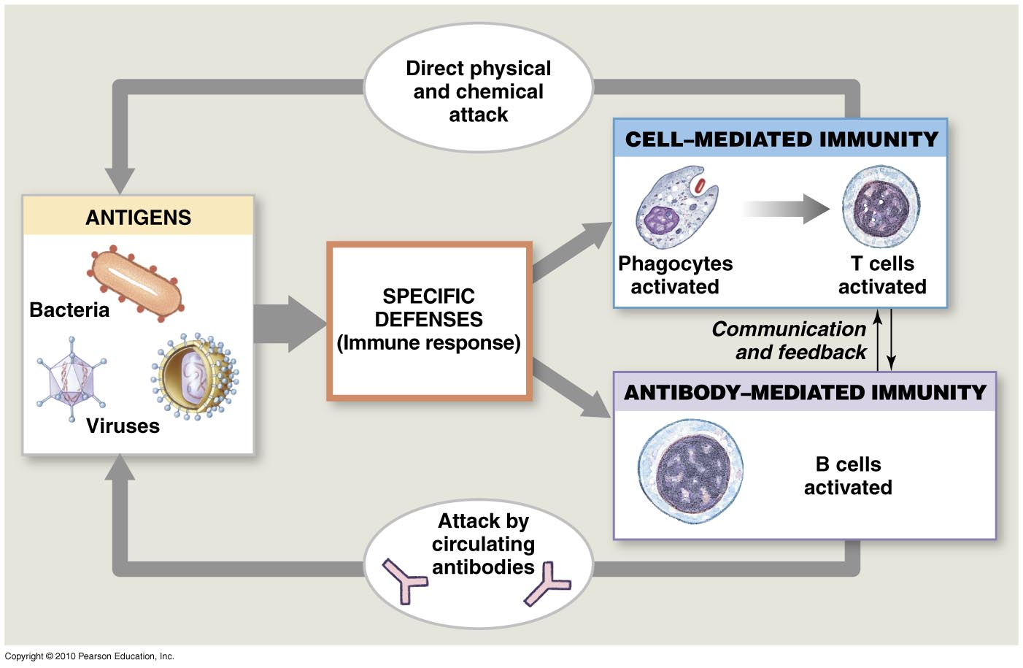
Specific Defenses (Immunity)
The differences between B and T cells

Slide 9
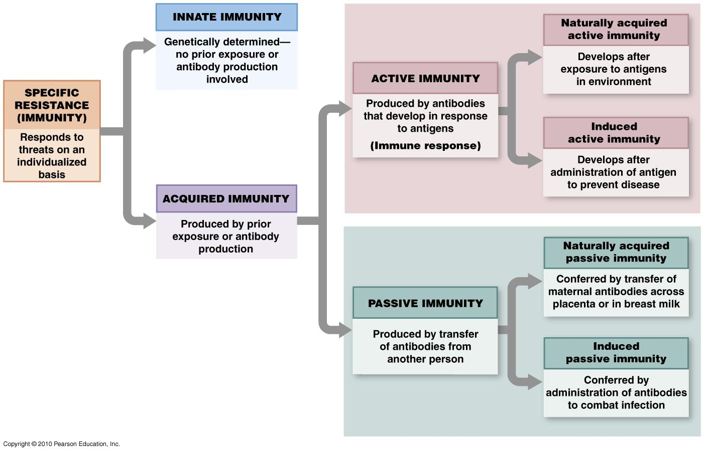
Specific Defenses (Immunity)

Slide 10
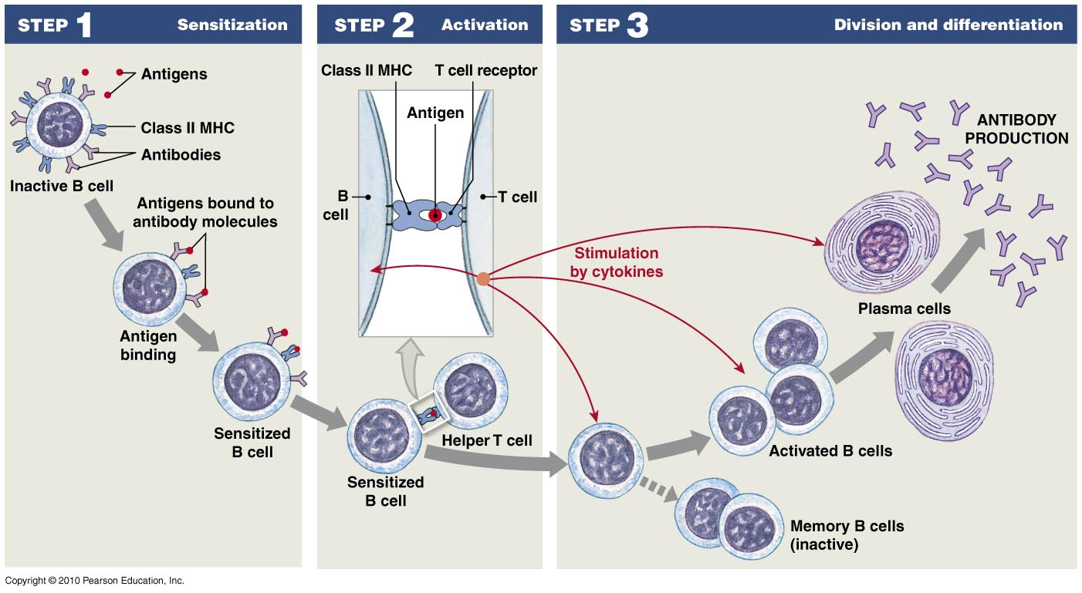
B Cell (Antibody Mediated) Defense

Slide 11
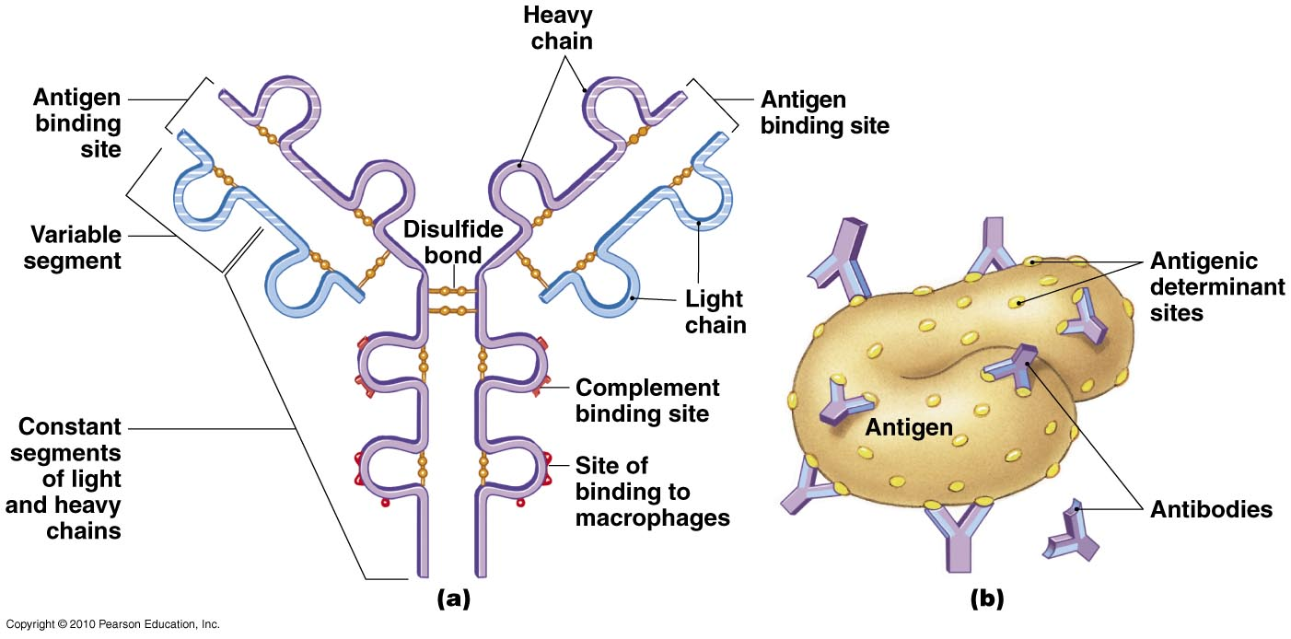
B Cell (Antibody Mediated) Defense
What are antibodies?
  Antibodies (Ab’s) are proteins (immunoglobulins)
    Have variable regions which can be made to fit nearly an endless variety of shapes

Slide 12
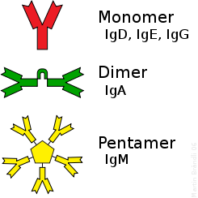
B Cell (Antibody Mediated) Defense
Classes & Forms of Antibodies
IgA | Found in mucosal areas, such as the gut, respiratory tract and urogenital tract, and prevents colonization by pathogens. Also found in saliva, tears, and breast milk.
IgD | Functions mainly as an antigen receptor on B cells that have not been exposed to antigens. It has been shown to activate basophils and mast cells to produce antimicrobial factors.
IgE | Binds to allergens and triggers histamine release from mast cells, eosinophils and basophils, and is involved in allergy. Also protects against parasitic worms.
IgG | In its four forms, provides the majority of antibody-based immunity against invading pathogens. The only antibody capable of crossing the placenta to give passive immunity to fetus.
IgM | Expressed on the surface of B cells and in a secreted form with very high avidity. Eliminates pathogens in the early stages of B cell mediated (humoral) immunity before there is sufficient IgG.

Slide 13
B Cell (Antibody Mediated) Defense
What do Antibodies (Ab’s) do?
  Enhance phagocytosis by:
    1. Opsonizing
      Attaching to antigen to make it easier for phagocytes to engulf
    2. Neutralizing
      Bind to the antigen and render it non-toxic
    3. Chelating
      Coating smaller antigens, making them insoluble
    4. Agglutinating
      Clumping together to ease phagocytosis
  Play a role in the non-specific complement pathway

Slide 14
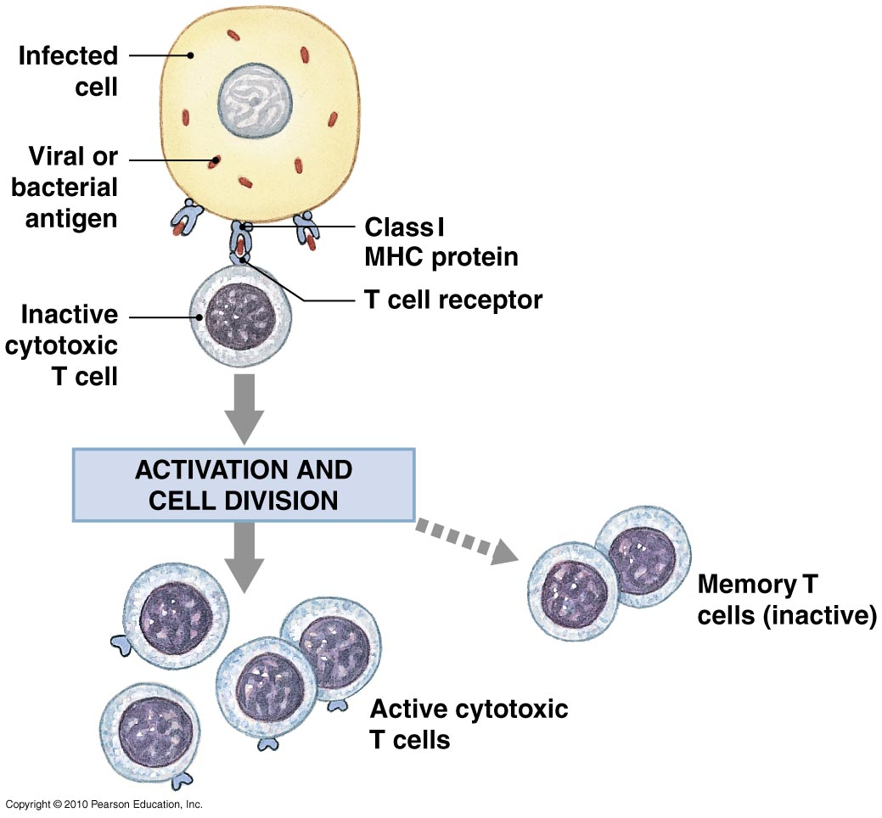
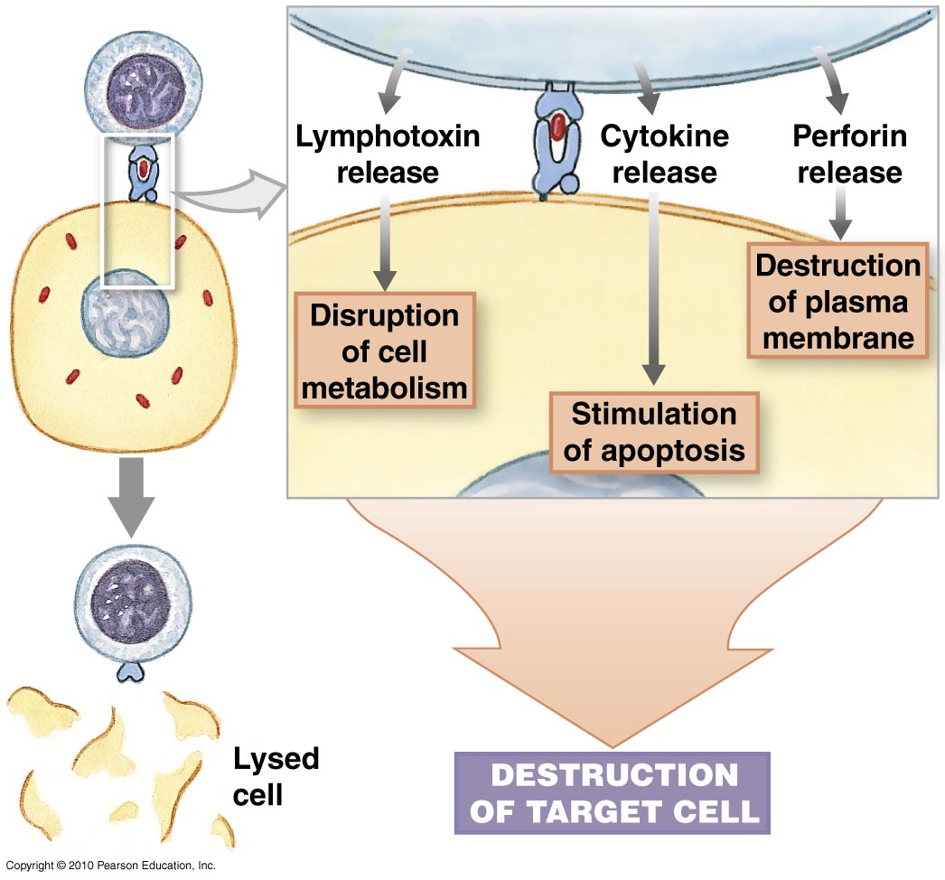
T Cell (cell mediated) Defense
00

Slide 15
T Cell (cell mediated) Defense
Type of lymphocyte
Once activated create cytotoxic T cells or T killer cells that
  Lyse the cell using perforins
  Chemically induce cell death
  Interfere with cellular metabolic pathways

Slide 16
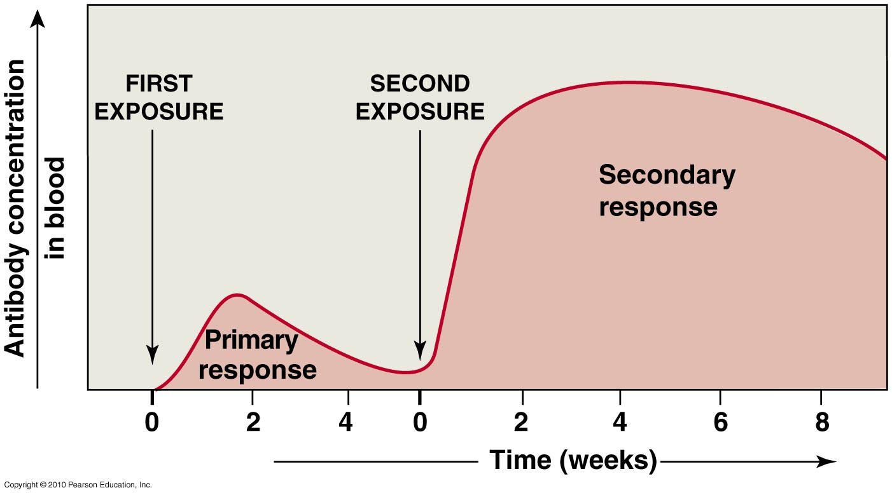
What is the benefit of antibody or cell mediated immunity?
It’s all about the next time the antigen show’s its’ foreign little parts!

Slide 17
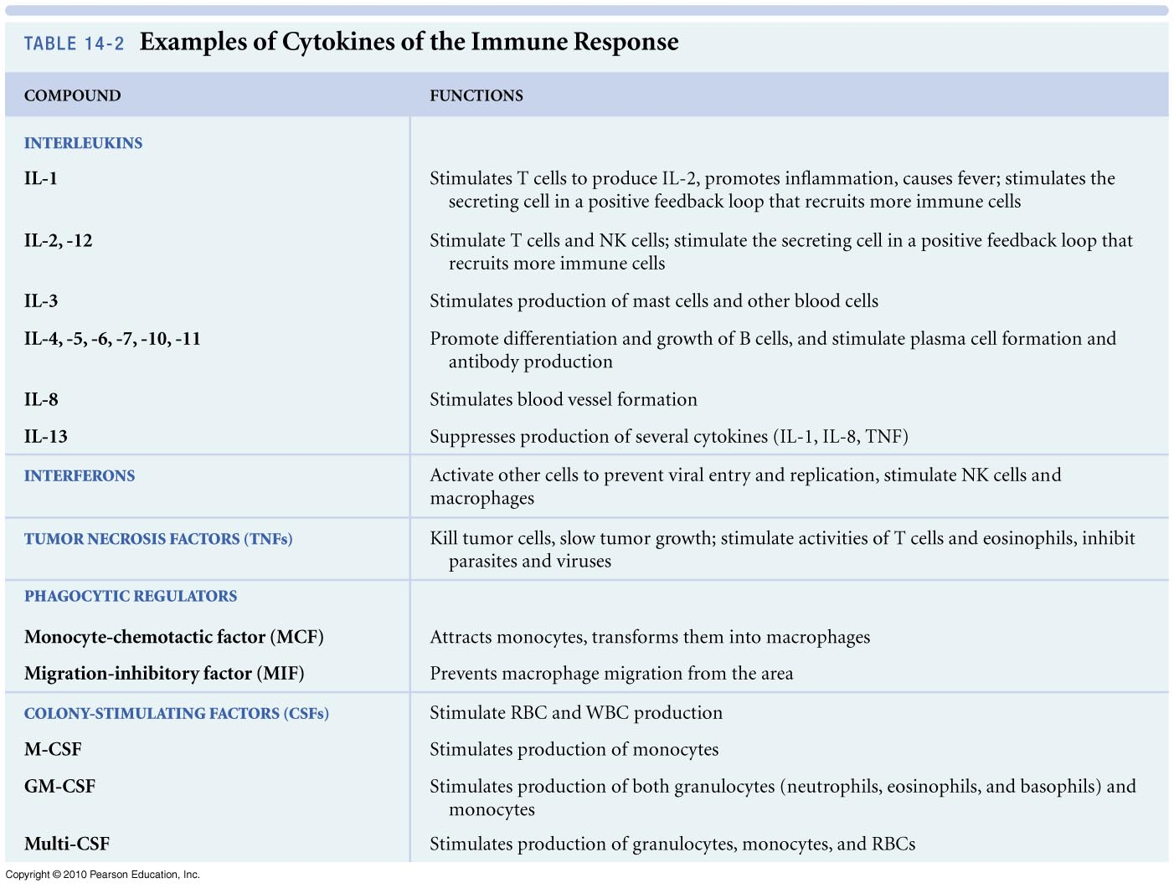
Cytokines all purpose chemical messengers

